Slide 1

Smart healthcare
Team: Something

Slide 2
Team : Something
Rahul soni (Nirma University)
(rahuldsoni2001@gmail.com)
Rupen chitroda (Nirma University)
Sakshi bedarkar (Nirma University)
Tushar harsora (Nirma University)
Vishwa gandhi (Nirma University)

Slide 3
Problem definition
Being able to have machines understand unstructured textual content already plays a big part nowadays in our life. NLP can contribute largely to the advancement of medical science. NLP is used to extract information from free text narratives written by a variety of healthcare providers. Here we approach natural language processing algorithm where we (1) Evaluate the free text and compare it with the dataset of NLP Dictionary (2) Annotated the important textual content from the text like Medication, Investigation (Pathology, Radiology), Chief Complaint. (3) After Segregation the highlighted data should automatically enter the flow of EMR.

Slide 4
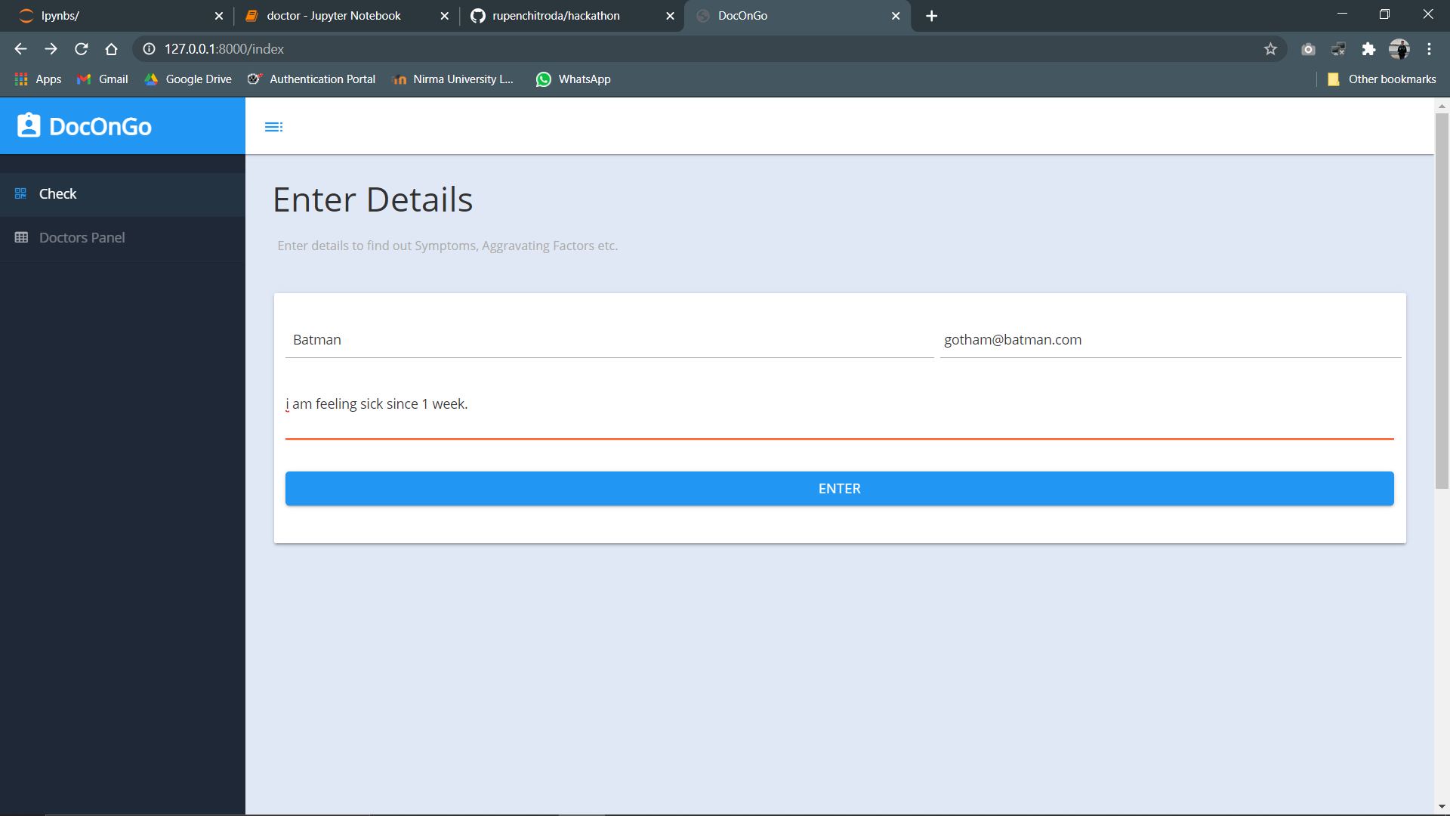

Slide 5
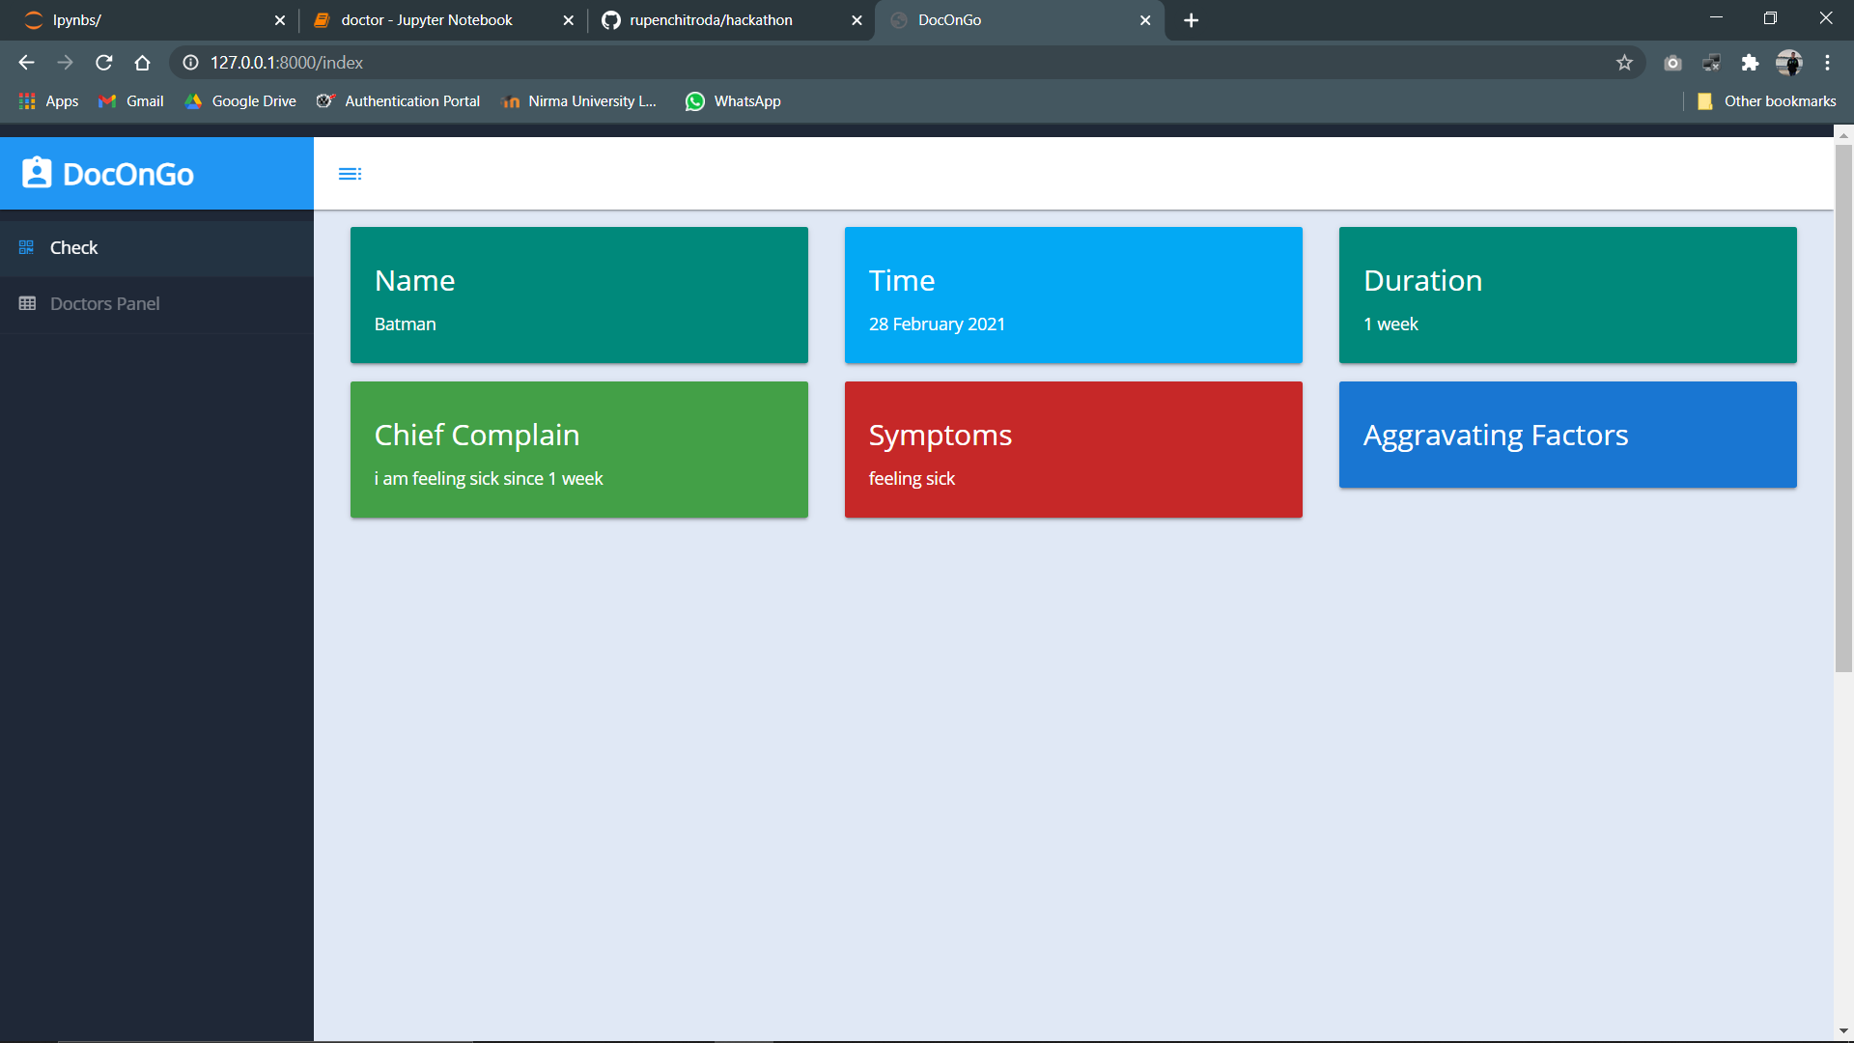

Slide 6
Columns
Duration: finds out how long have patient been experiencing.
Symptom: finds out what problem patient have been facing.
Aggregated factor: provides what time patient have been feeling the problem
Chief complain: full description of problem by patient in their own words
Name & date: basic details of who patient is and what day they registered complain.

Slide 7
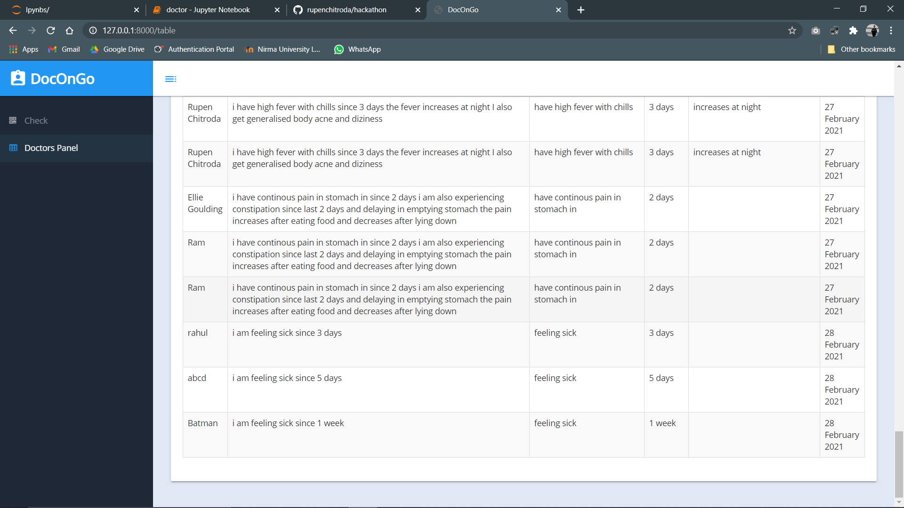

Slide 8
Flow of code
As patient submits the story, whole description goes to views.py file in backend.
Here necessary parts of sentence are extracted and stored in dictionary object.
Also with other details like name and date, it is stored in ‘.csv’ file for doctor’s reference.
Patient itself can view brief about their report.
Doctor can view all details of patient in table format on their side.

Slide 9
Future expansion
We can add feature where patient can directly communicate through doctor using VoIP
Doctor can also prescribe patient for necessary medication via email.
We can introduce machine learning to see particular pattern on issue patients are having like if more of eye related problem arise recently.

Slide 10
Thank you.

